Slide 1
P1T2-Array-of-Sunshine
Group 2
Ryan Gayle
Stuart Gross
Jonathan Hummer
Sheikh Iftekhar

Slide 2
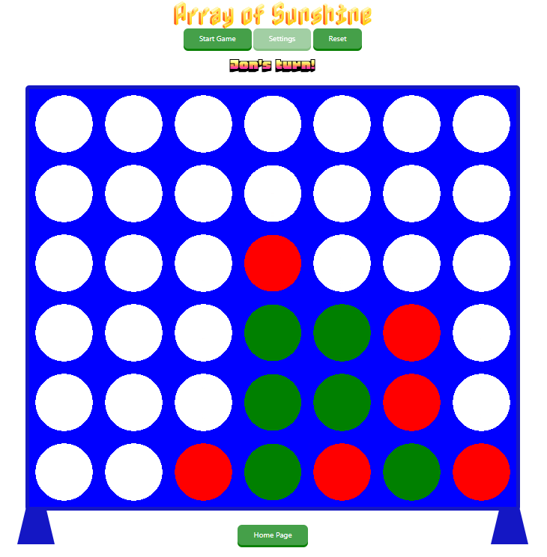

Slide 3
Level up your logic skills with our Connect 4-inspired game, built from the ground up using HTML, CSS, and JavaScript! Designed as a coding bootcamp project, this interactive web game delivers a fun and engaging experience while showcasing dynamic UI updates, responsive design, and core JavaScript functionality. Play against a friend, test your strategic thinking, and see how simple web technologies come together to create an immersive gameplay experience!

Slide 4
Concept
Description
Array of Sunshine is a web-based twist on the classic game, built with HTML, CSS, and JavaScript for an interactive and personalized experience. Players can choose custom token colors and create a username that persists via local storage. Smooth animations bring the game to life as tokens drop into place, while an intuitive message UI guides players with turn-based prompts and victory messages. With its dynamic visuals and engaging mechanics, Array of Sunshine offers a fresh, fun way to enjoy this timeless strategy game.
Motivation for development?
Connect 4 is a relatively simple game in terms of rules and strategy, but would allow us to use the methods learned in class in a comprehensive, interactive way. The MVP is a challenge in itself, and the sky is the limit with added functions and features.
User story
As a player, I want to customize my game experience by selecting my own token color and creating a unique username that saves for future sessions, so I can feel more connected to the game. I want smooth, animated gameplay where tokens drop seamlessly into place, making each move visually satisfying. Throughout the game, I expect clear and engaging messages that prompt my actions, indicate turns, and celebrate wins, so I always know what’s happening. Ultimately, I want an interactive, customizable and visually appealing way to enjoy the classic Connect 4 experience right in my browser.

Slide 5
Process
Technologies used
Bootstrap CSS Framework
Google Fonts
Breakdown of tasks and roles
HTML: Sheikh & Ryan
CSS: All
Javascript: Stuart & Jonathan
Animations: Stuart
Challenges
Win logic (array methods)
Modals
Animating chips dropping
Responsive pages (re-sizing)
Successes
Local storage (persistent objects)
Gameplay works!

Slide 6
Demonstration

Slide 7
Directions for Future Development
Ideas for future development:
Leaderboard (high scores)
Variable gameboard size
Draggable mouse animations (dropping chip)
Slide animation to reset
Gameplay variations: wildcard pieces, random start, timed game
Computer AI
Sound effects
Pictures instead of colors on tokens
More texture/animations
Rotation with viewport
Drop-down selection on modal with players from Local Storage

Slide 8
Links
Deployed
GitHub repo

